Slide 1

Spatial and temporal modelling

Slide 2
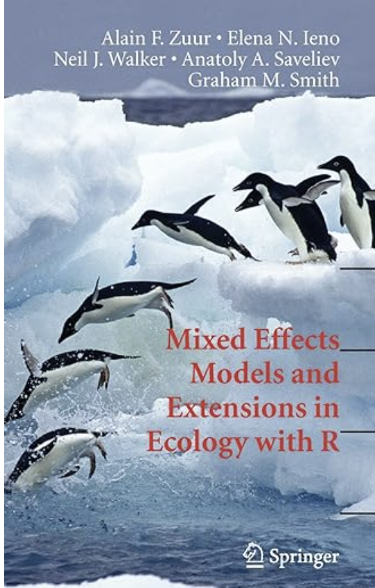
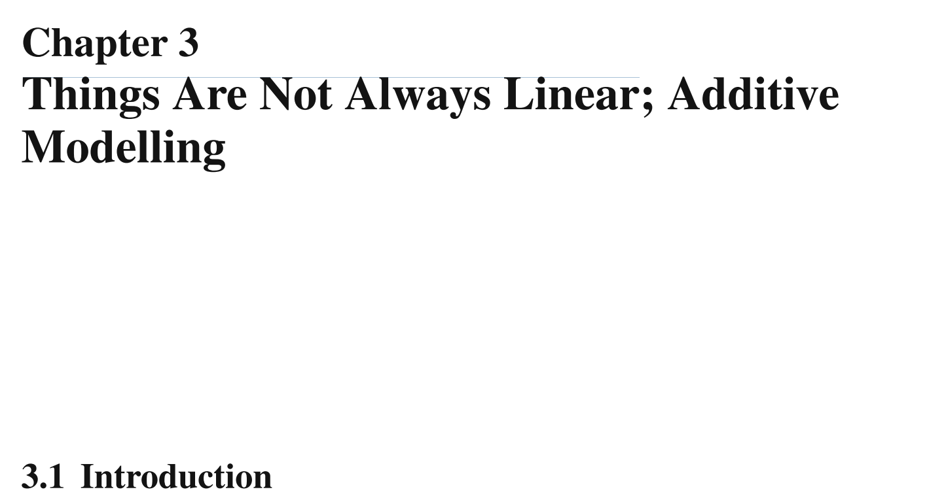
Things are not always linear

Slide 3
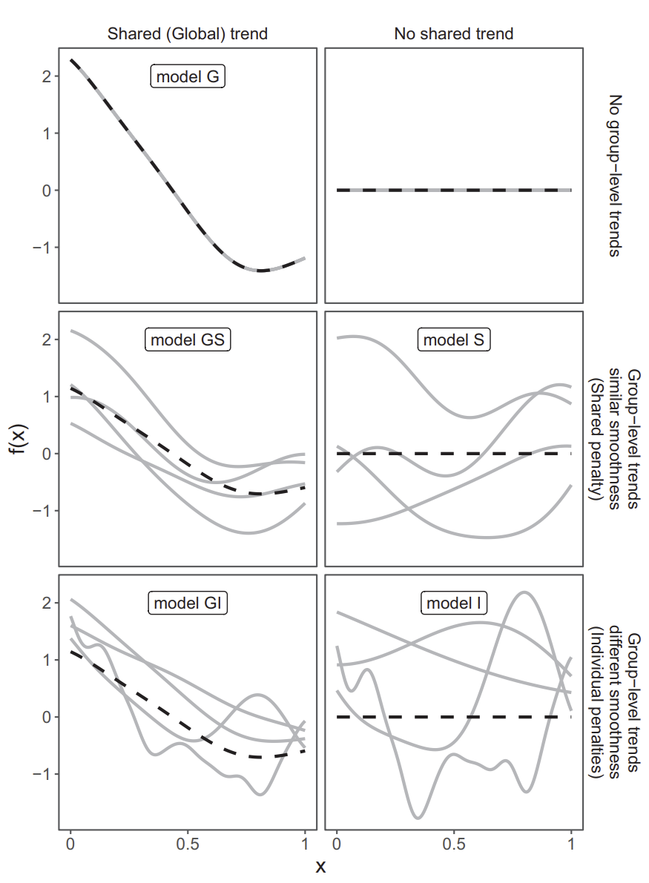
Hierarchical GAMs
Pedersen et al. 2019 (PeerJ)
Essential reference
Different approaches to wielding smooths

Slide 4
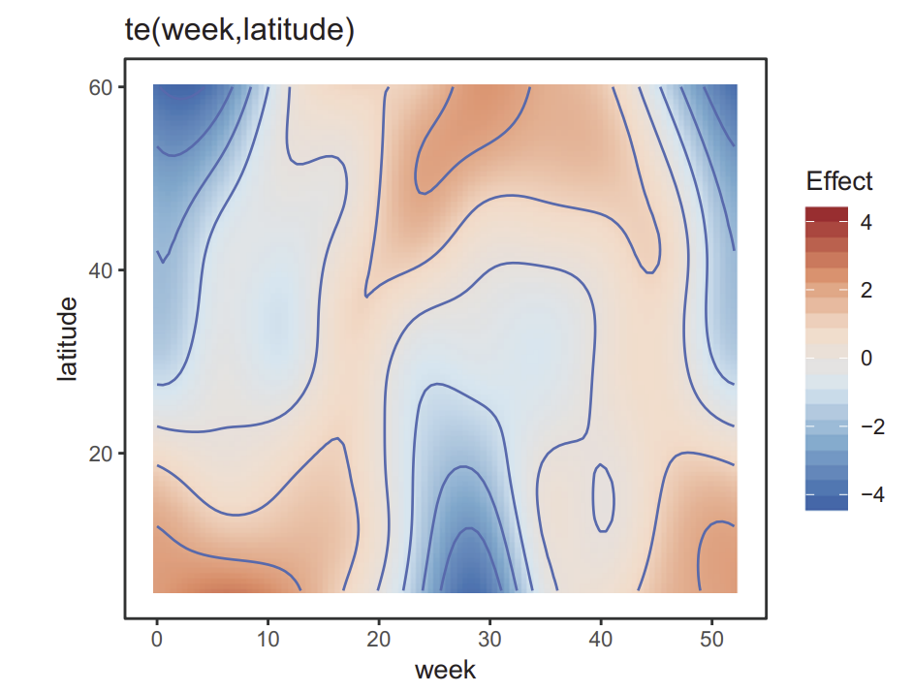
A brilliant example of space and time
Bird migrations
Temporal and spatial interactions
Explains variance and supports predictions
Pedersen et al. 2019 PeerJ

Slide 5
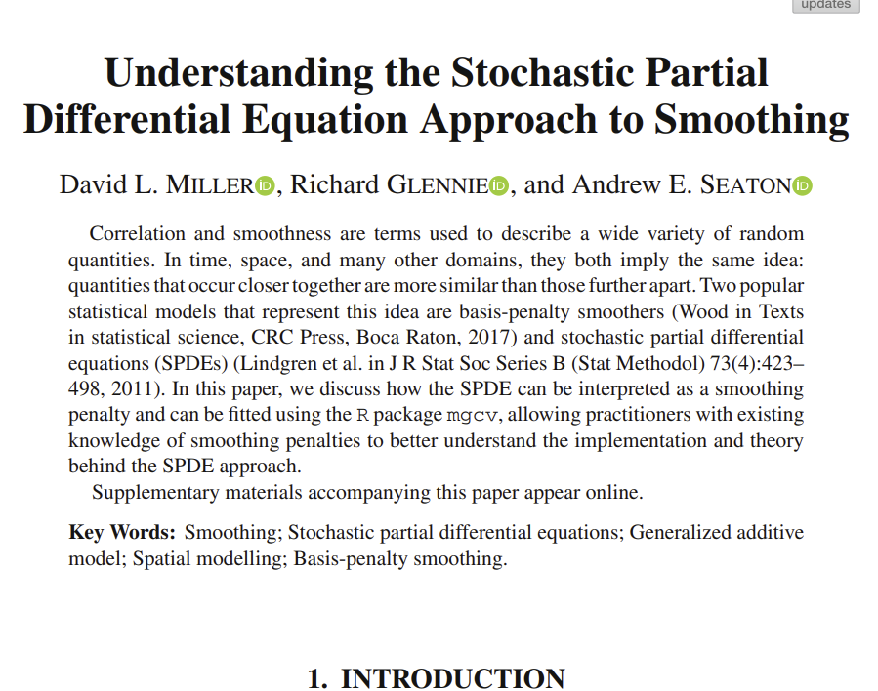
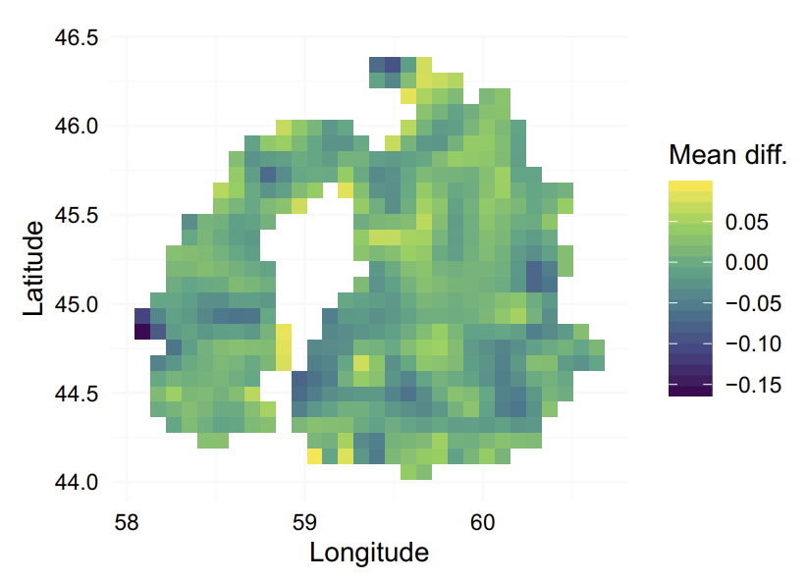
GAMs vs SPDE

Slide 6

~20 things to know about GAM modelling

Slide 7
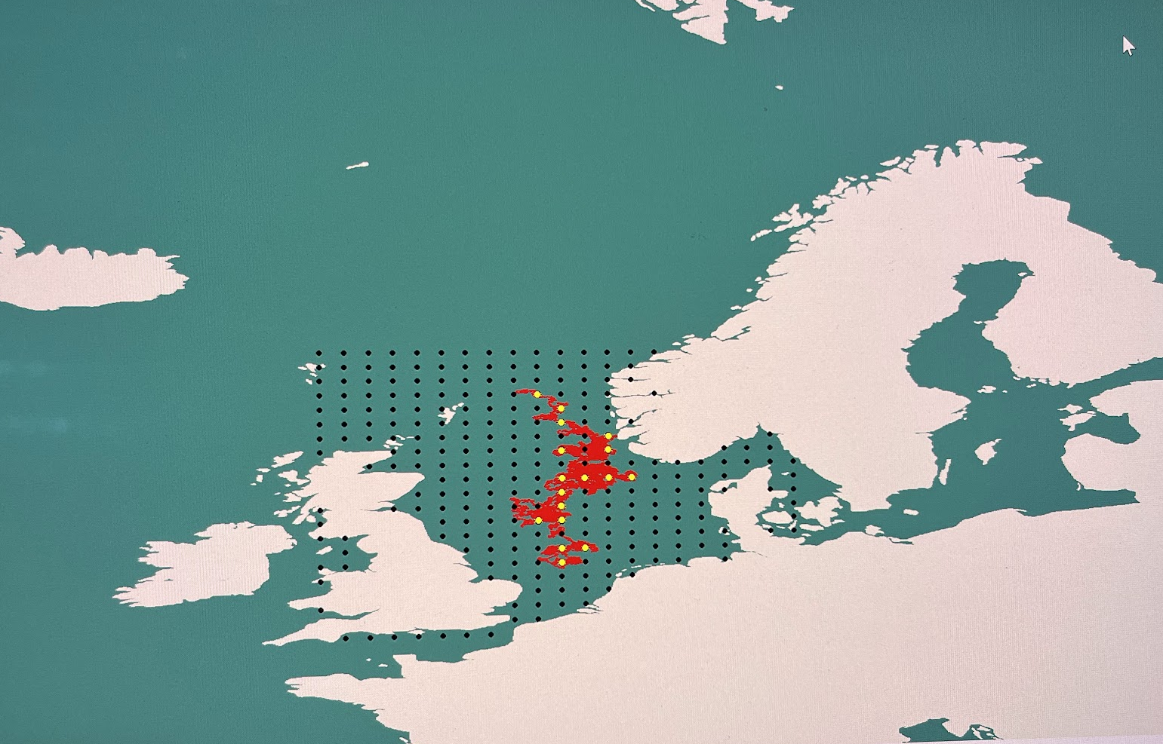
What to model
Spatial and temporal series
Multidimensional data
Hierarchical/mixed models
Essentially, telemetry data
But also, anything

Slide 8
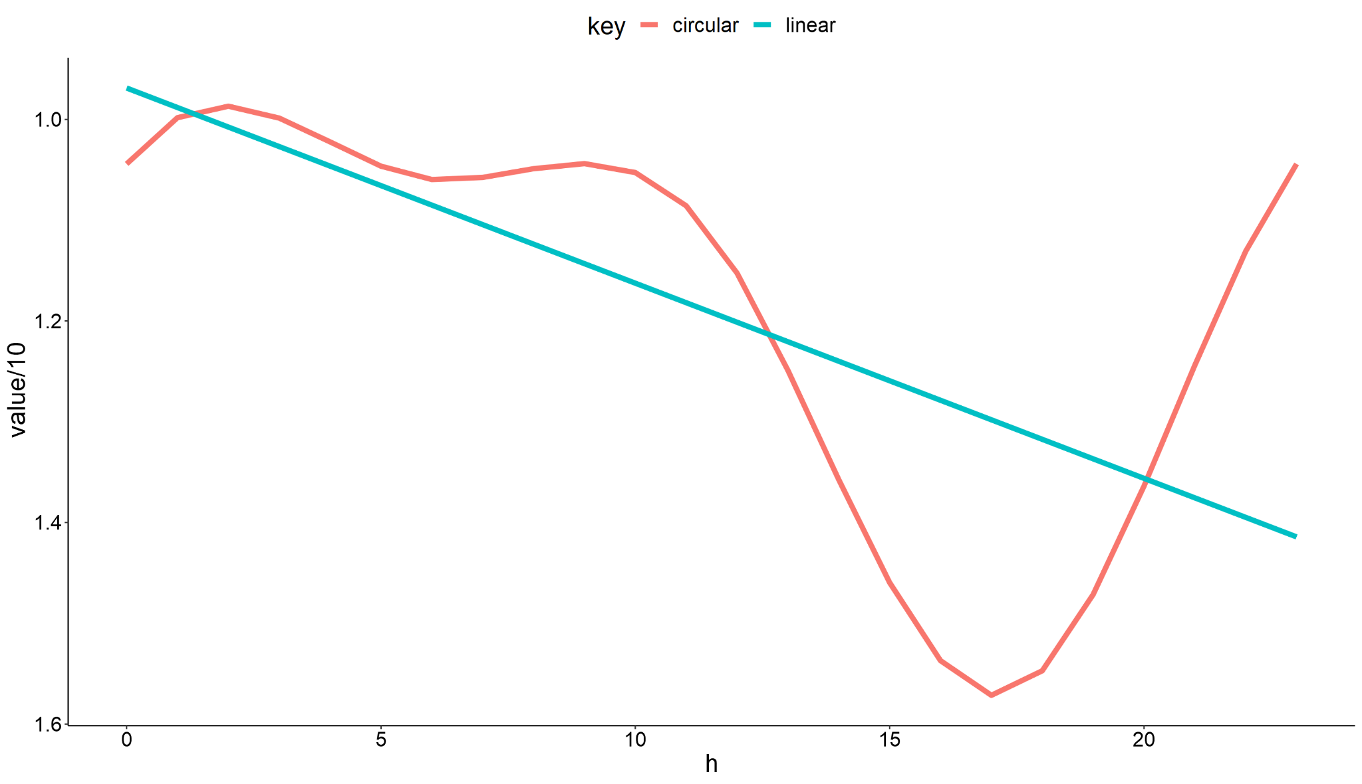
2. Going for smooth
A (straight) line not enough

Slide 9
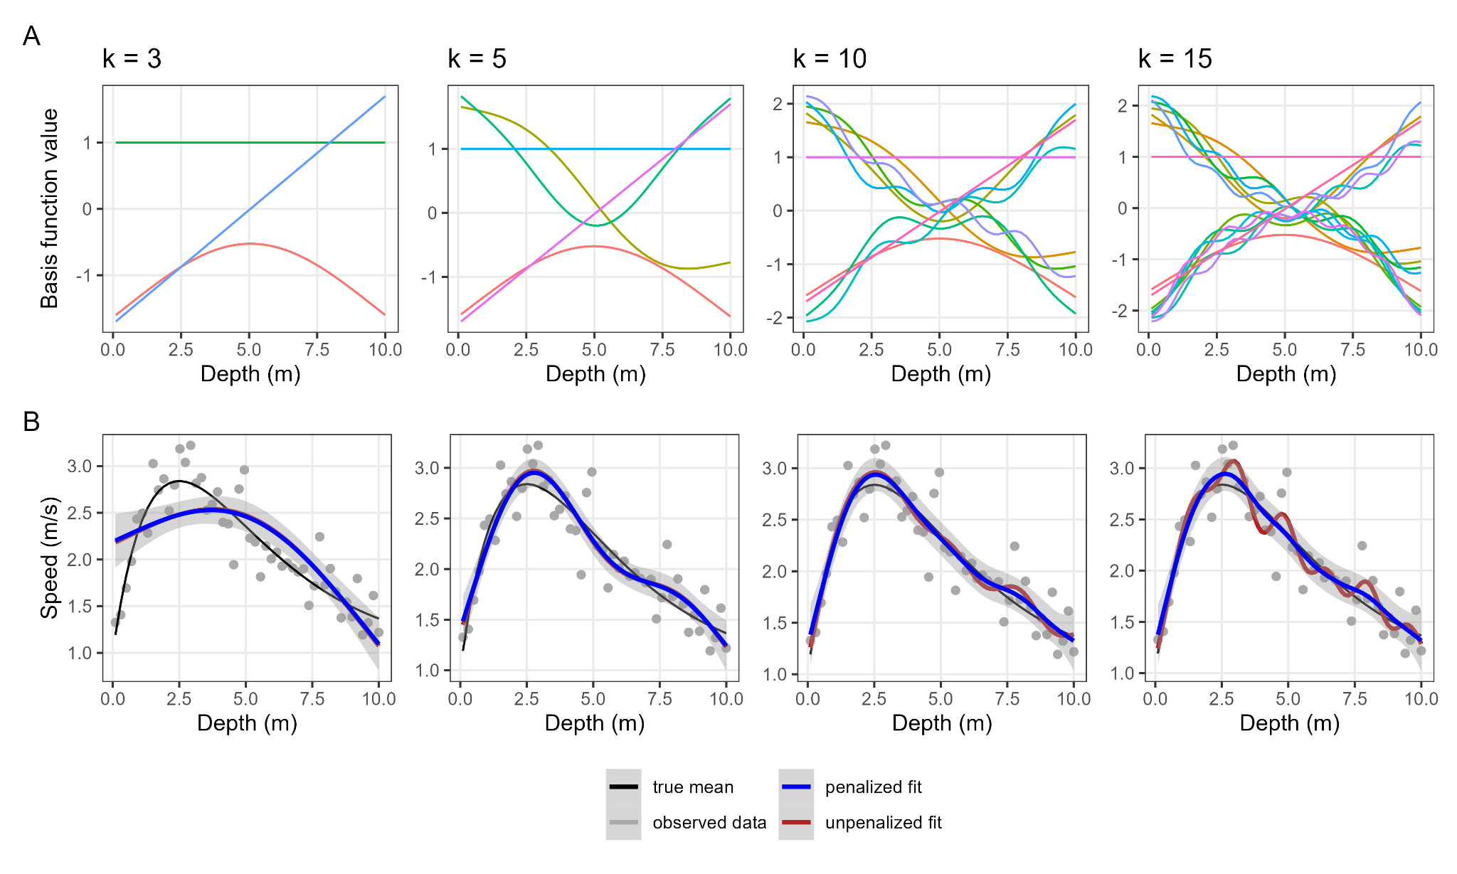
3. Basis functions

Slide 10

4. Develop an hypothesis with relevant interactions
Should be familiar
Modelling philosophy
Avoid random spaghetti throwing
Don’t accelerate rise of machines

Slide 11
5. Pick the right regression family
Gaussian | Change in depth, temperature, or acceleration, location along a one-dimensional gradient (e.g. latitude, longitude) where the zero point on the gradient is arbitrary | Pillans et al. (2022)
Binomial | Presence or absence, inside or outside area of interest, at risk or not at risk of exposure based on time and location of a detected animal, probability of being at rest at a given time | Lennox et al. (2022)
Conditional logistic | Modelling true presence and pseudo-absence data from tracking data on environmental covariates to calculate selection strength | McCabe et al. (2021) bird data
Cox.ph | Modelling time-to-event for individually tagged animals to reach an outcome such as departure from an area, recapture by fishers, or natural mortality (e.g. Whoriskey et al. 2019) with smoothed covariates. | Storms et al. (2022) tracked moths
Negative binomial | Count of individuals at a location | Bino et al. (2018)
Poisson | Count of individuals at a location | Hessler et al. (2023)
Gamma | Depth, temperature, acceleration | Nash et al. 2022
Tweedie | Potentially can be used for modelling continuous zero-inflated variables, such as movement speed for individuals that alternate between moving and resting | Westrelin et al. (2018); Rodrigues et al. (2022)
Beta | Fraction of the day spent active, Depth as a fraction of the water column | Secor et al. (2021)

Slide 12
6. You can pick your preferred gam function
mgcv::gam (nlme model fitting)
mgcv::gamm
mgcv::bam
gamm4::gamm4 (lme4 model fitting)
brms::brm

Slide 13
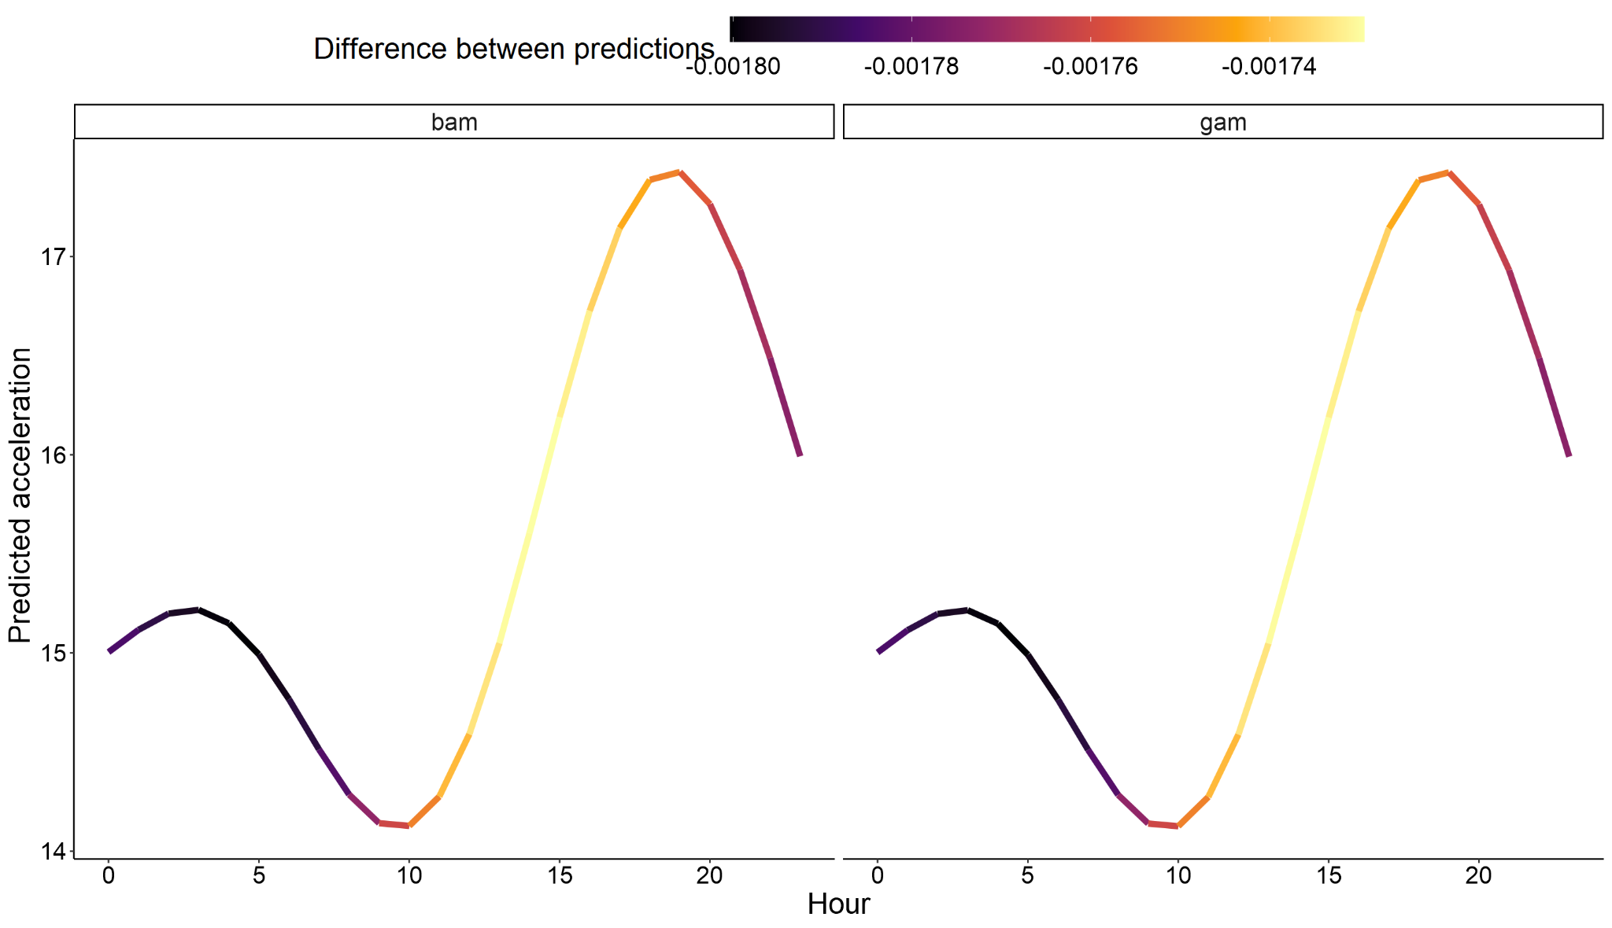
6. You can pick your preferred gam function

Slide 14
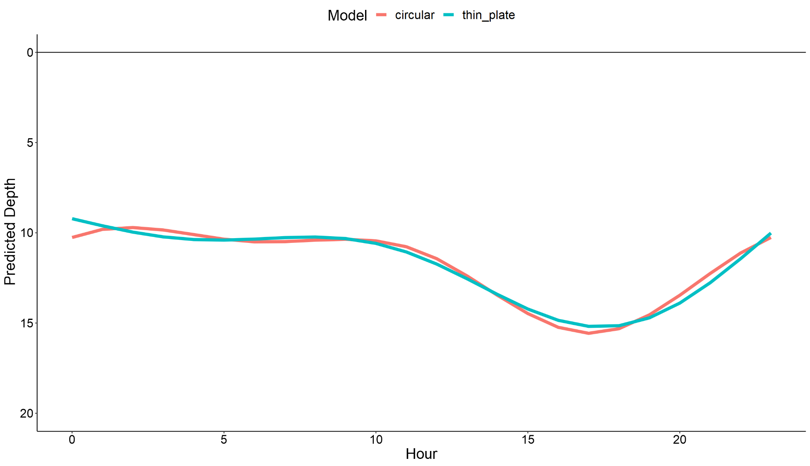
7. Choosing a smoother
Not all smoothers are the same
Don’t care about AIC.. specify correctly
Thin plate default
Circular smoother
Many others..
Soap film
Markov random field

Slide 15
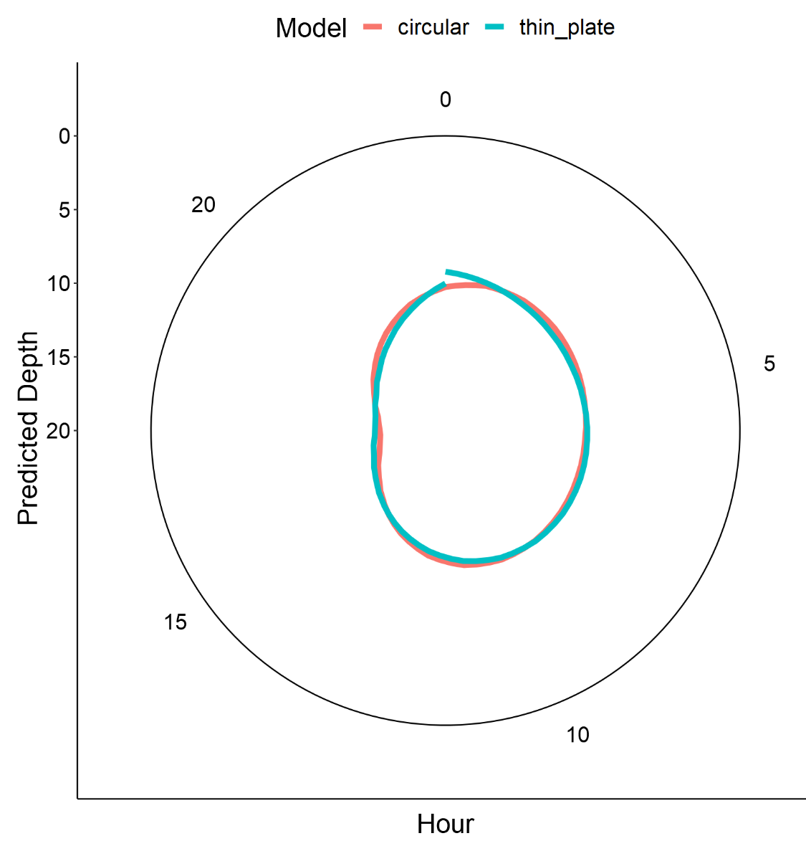
7. Choosing a smoother
Not all smoothers are the same
Thin plate default
Circular smoother
Many others..
Soap film
Markov random field

Slide 16
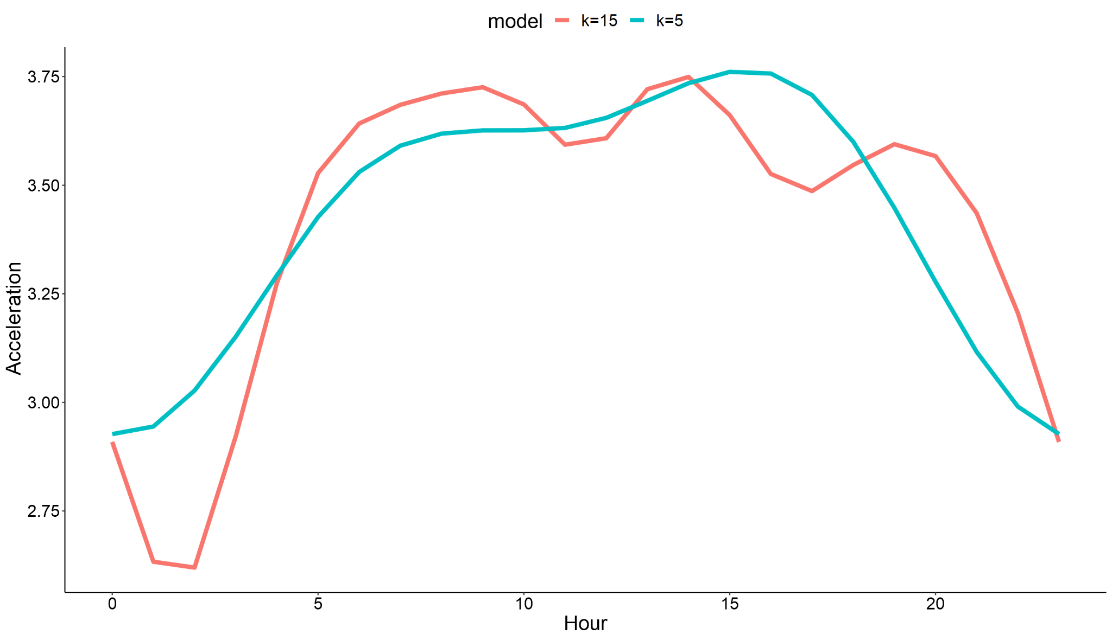
8. Check your knots
Modify k-value
Default is 10
Do not use default

Slide 17
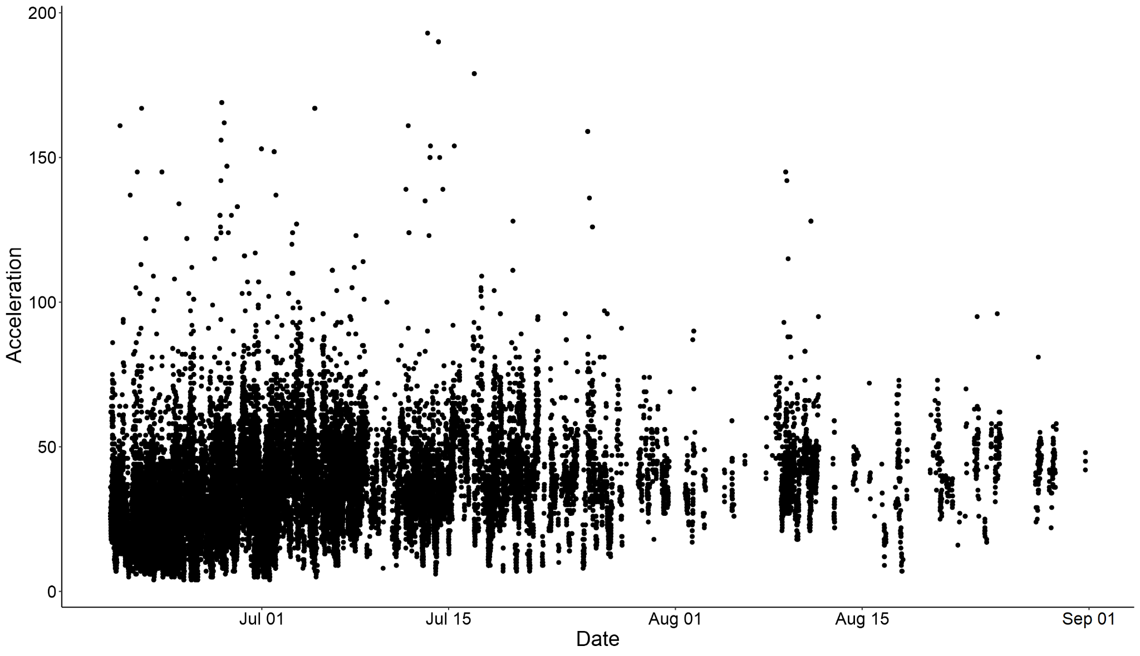
9. Temporal dependency

Slide 18
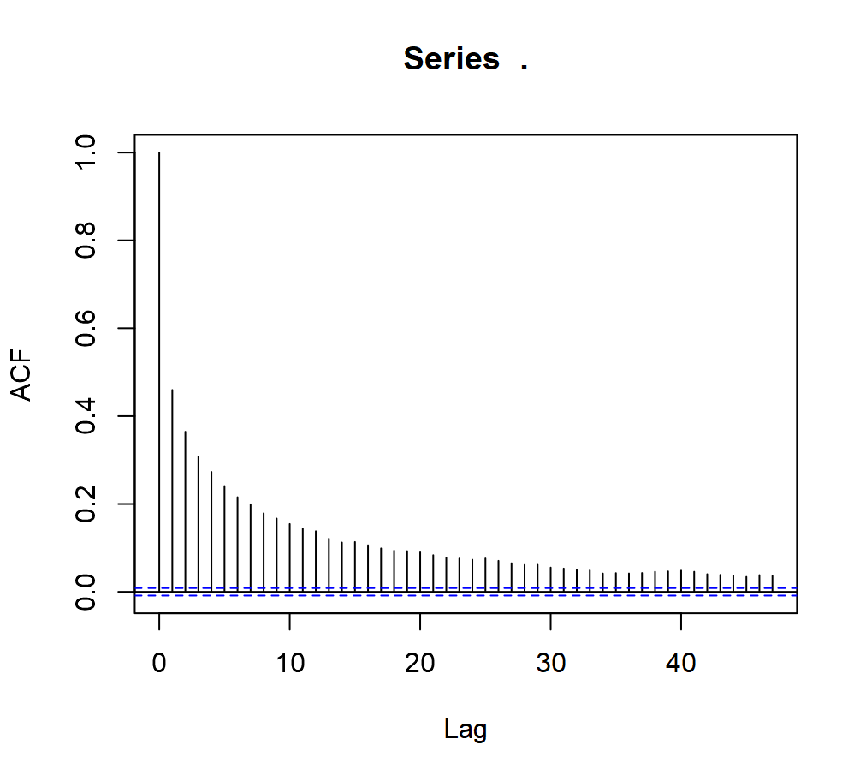
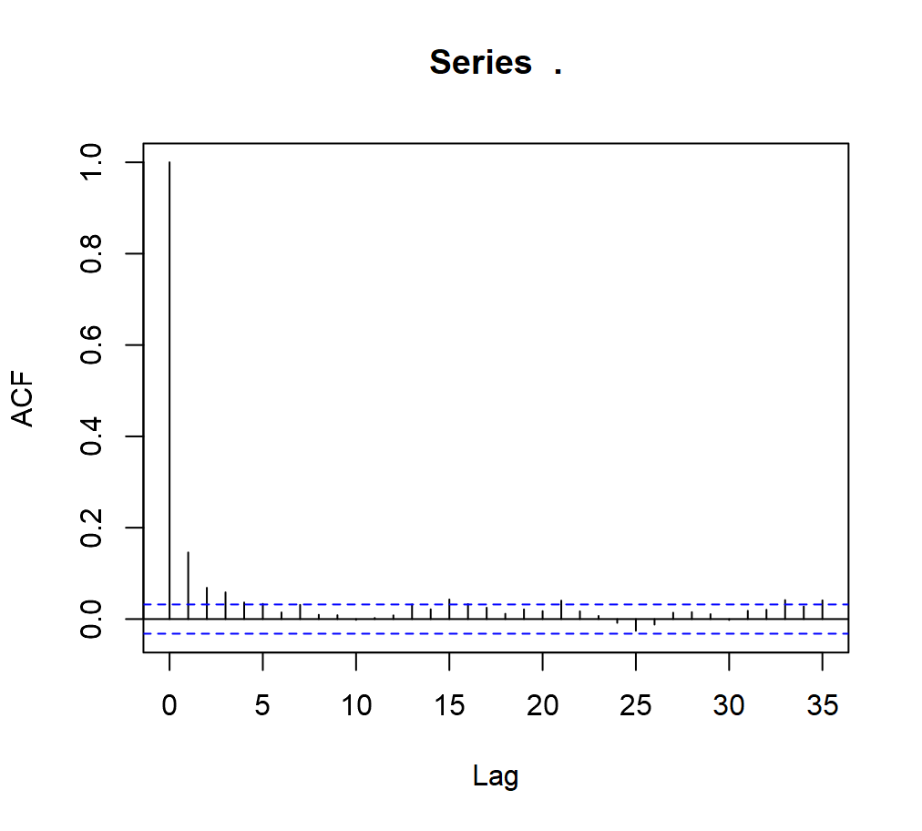
9. Temporal dependency
Full time series highly autocorrelated
Subset series has less autocorrelation

Slide 19
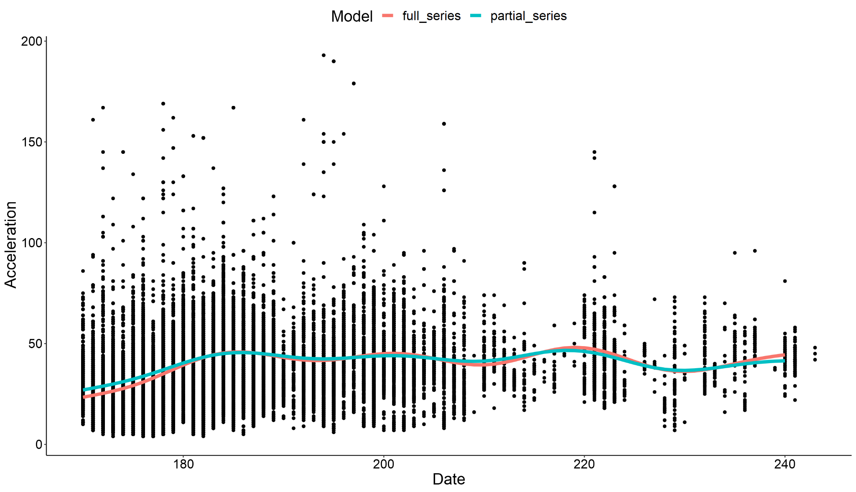
9. Temporal dependency

Slide 20
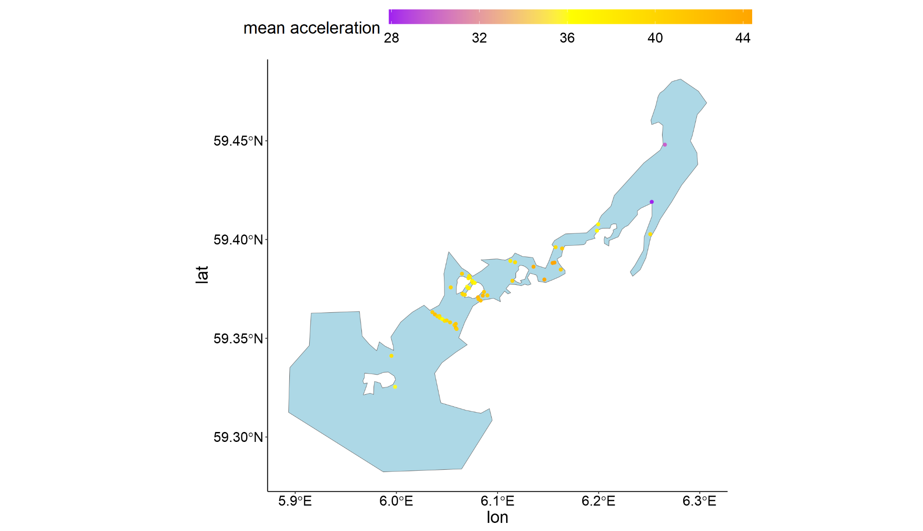
10. Spatial dependency

Slide 21
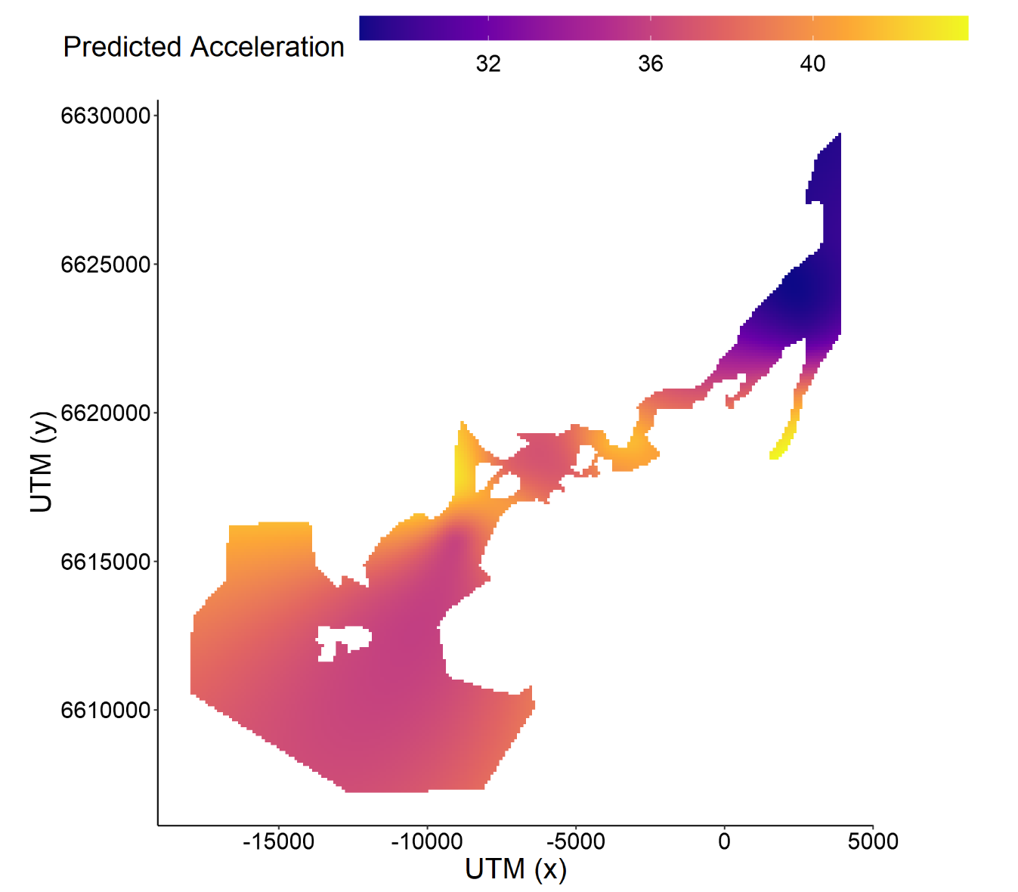
10. Spatial dependency
We can make spatial predictions!
Attribute partial effects to space by smoothing
Identify hotspots where more energy is required
Energy landscape?
HOW IS IT POSSIBLE

Slide 22
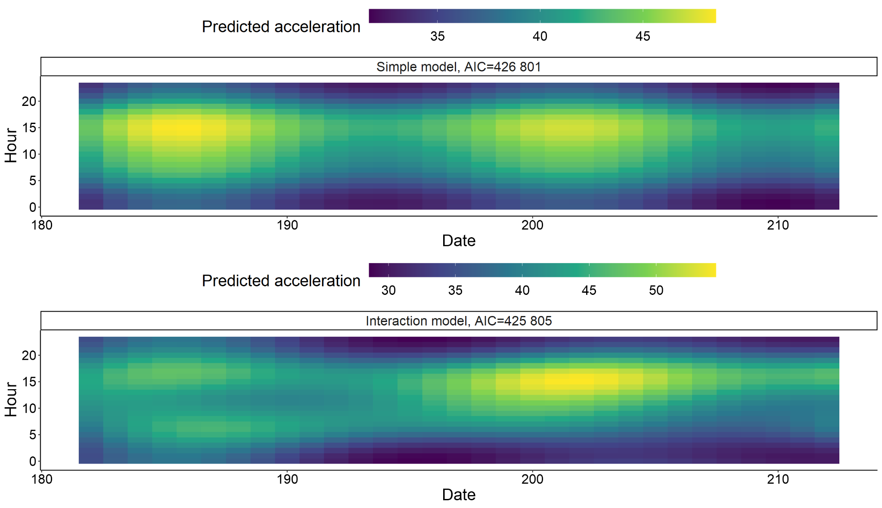
14. Consider potential interactions

Slide 23
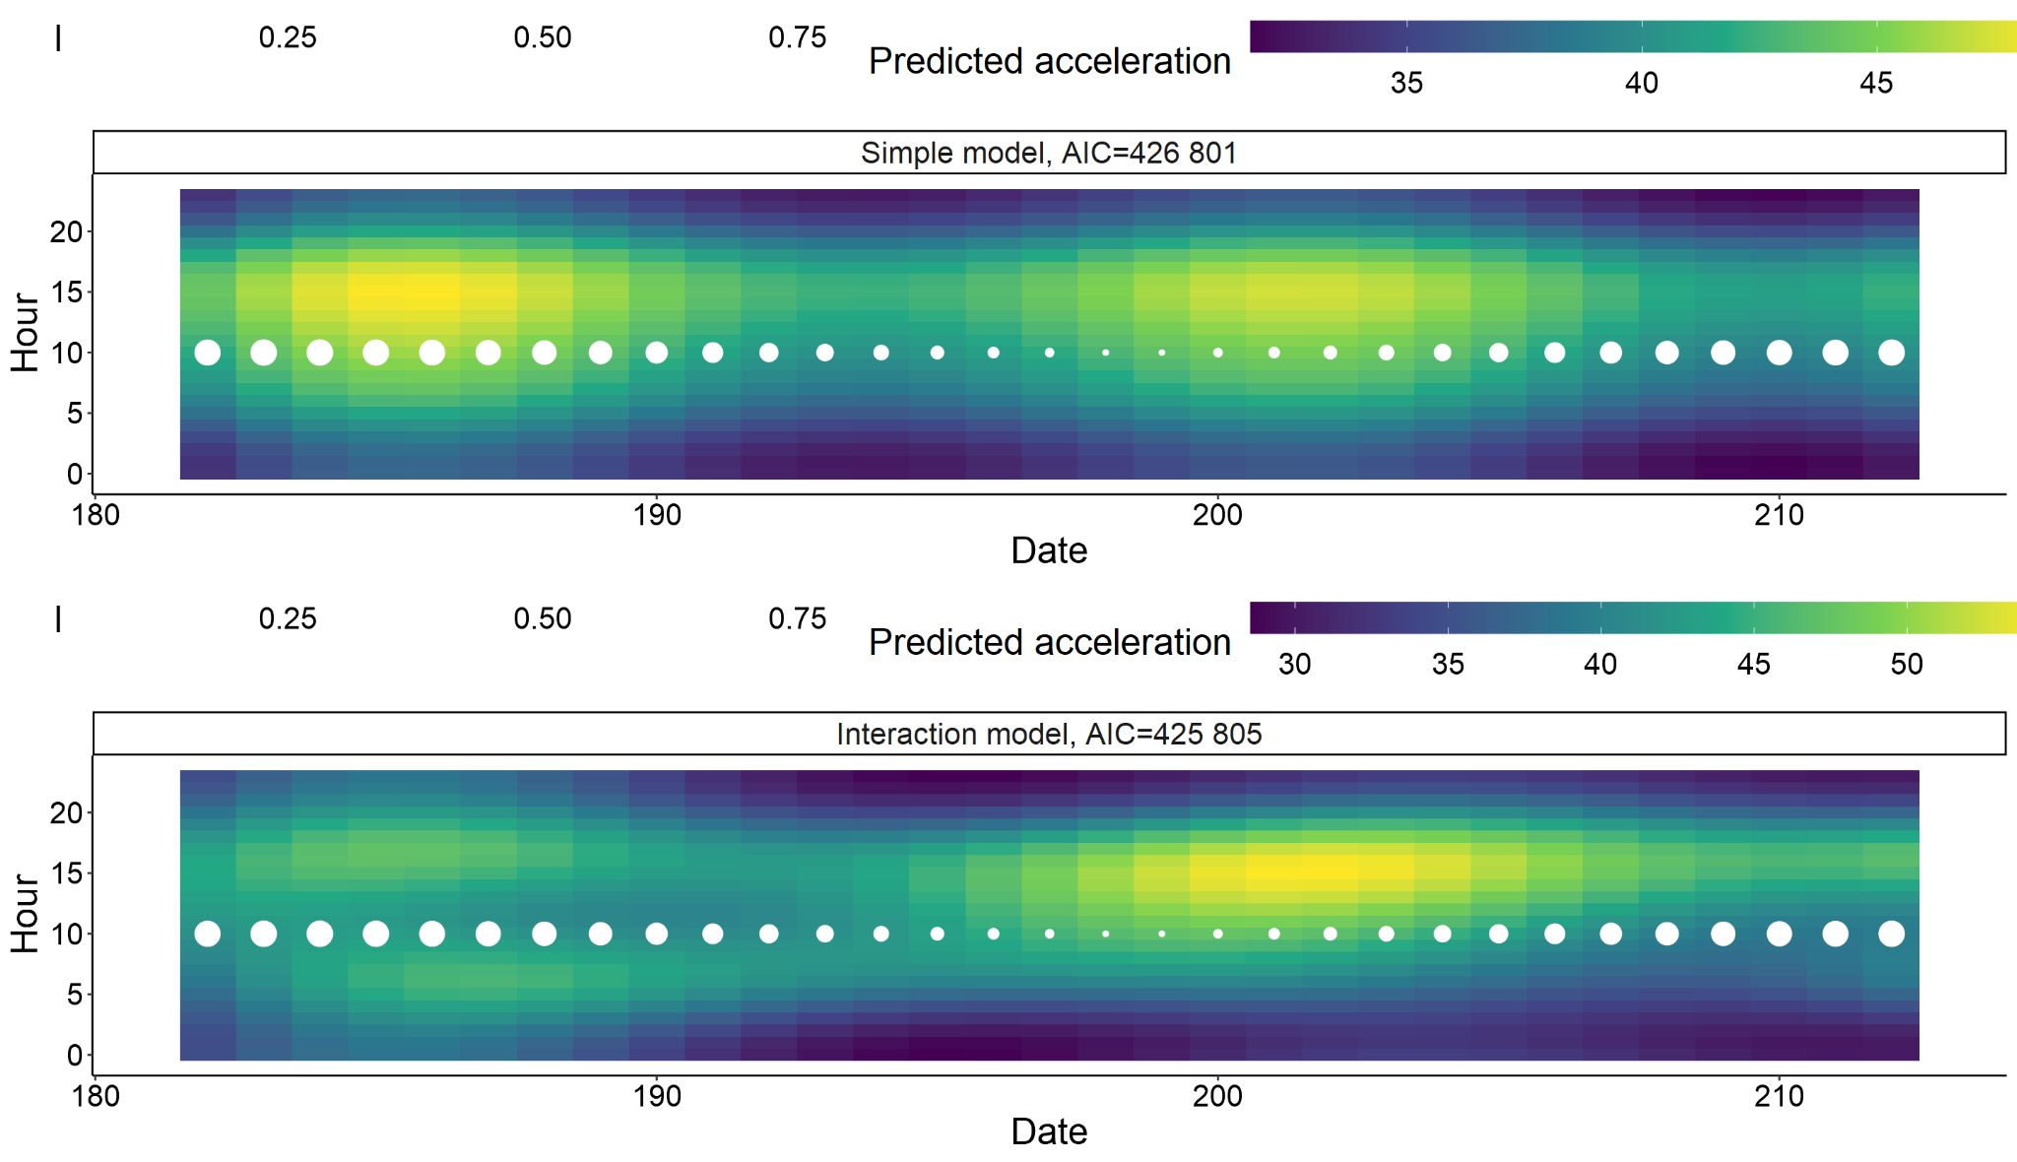
Are they influenced by the moon?

Slide 24
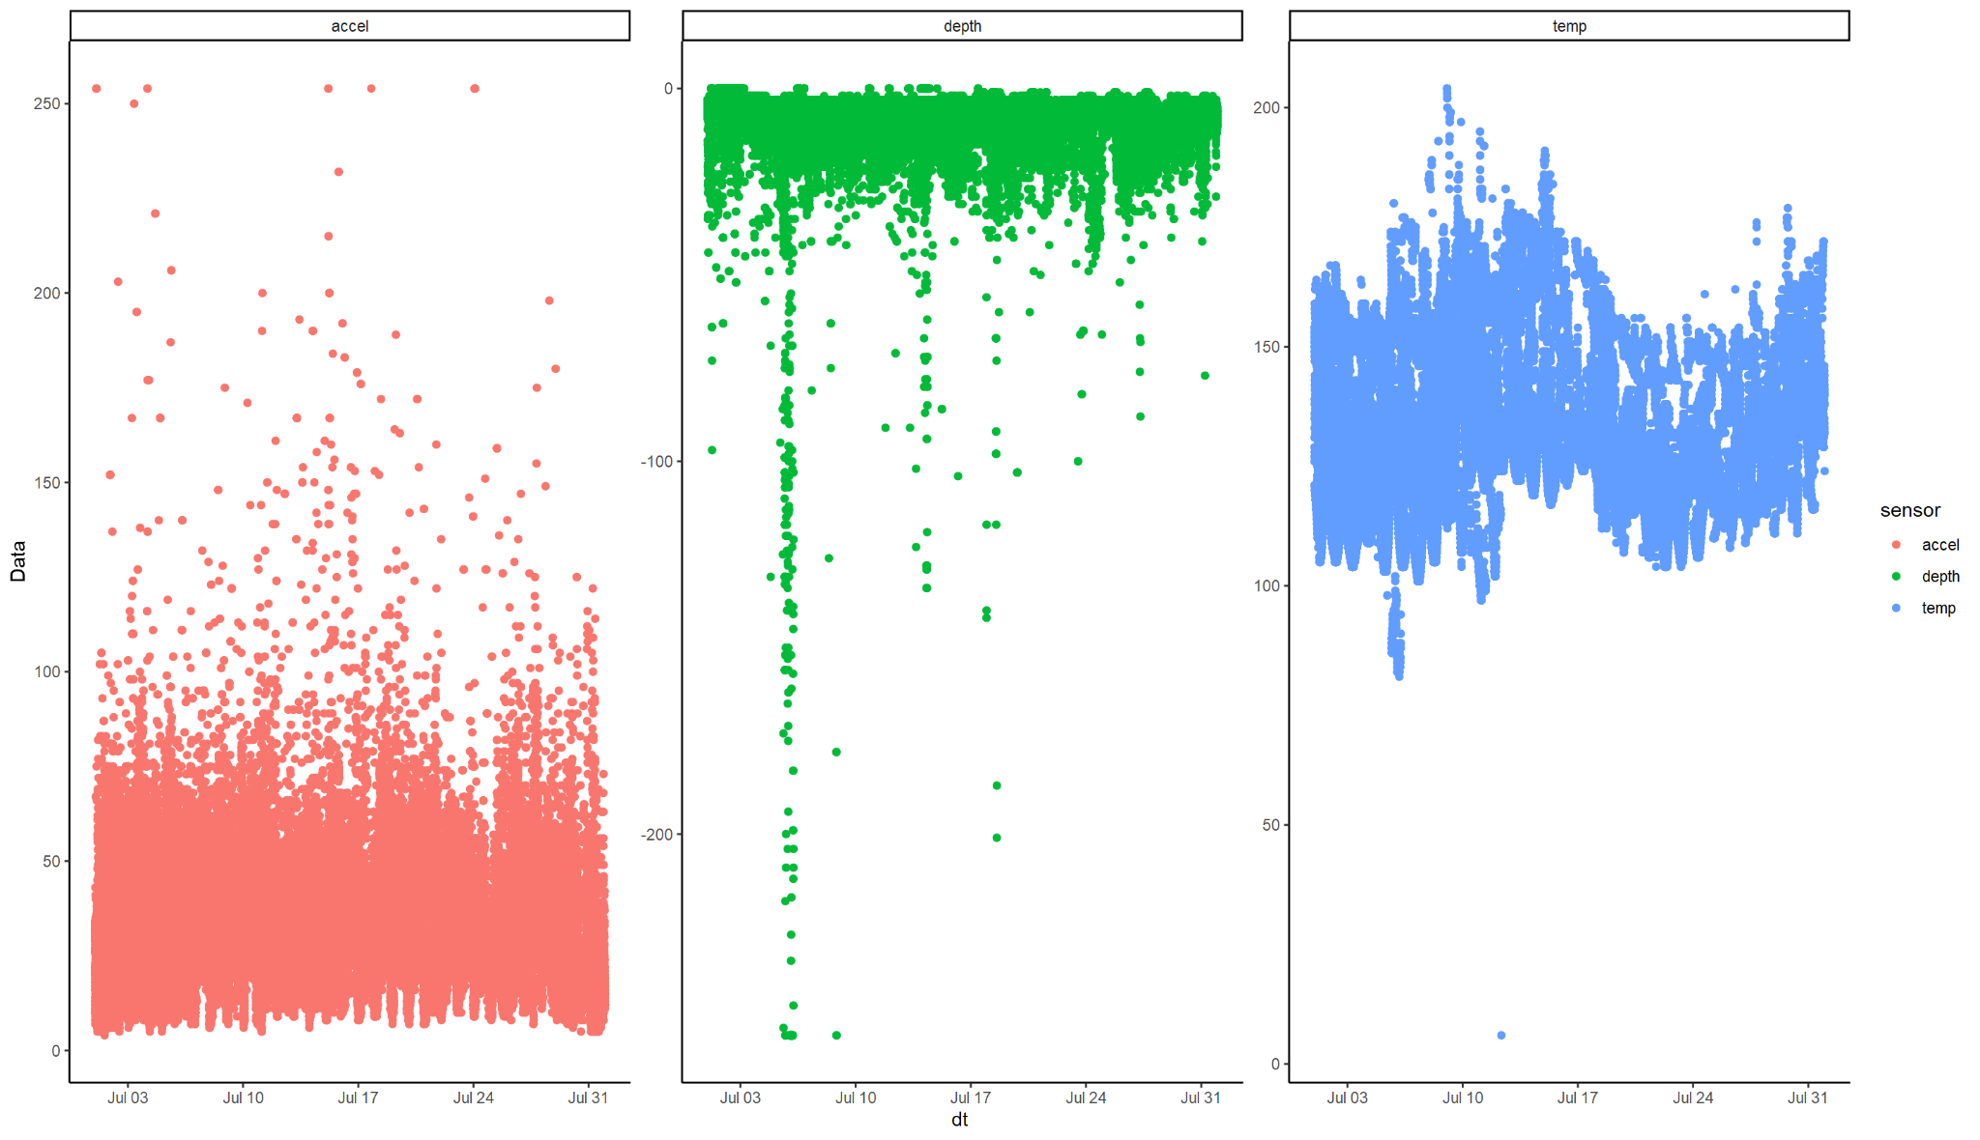
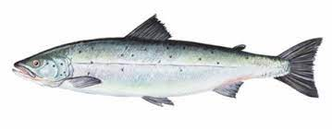

Slide 25
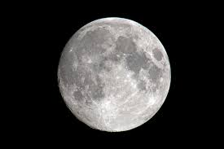
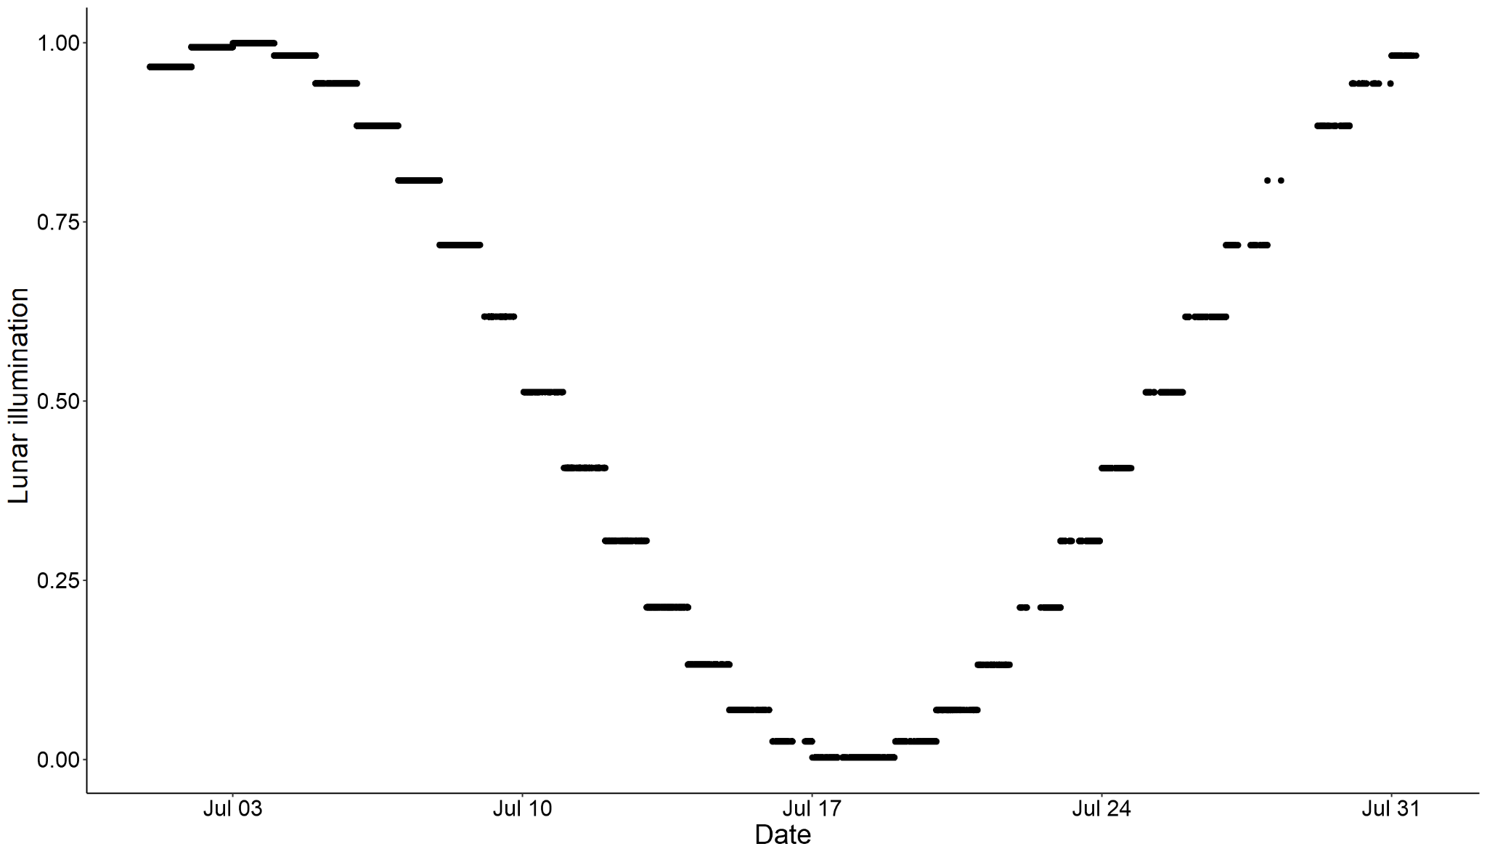
Working example
MOON
Important correlation to date

Slide 26
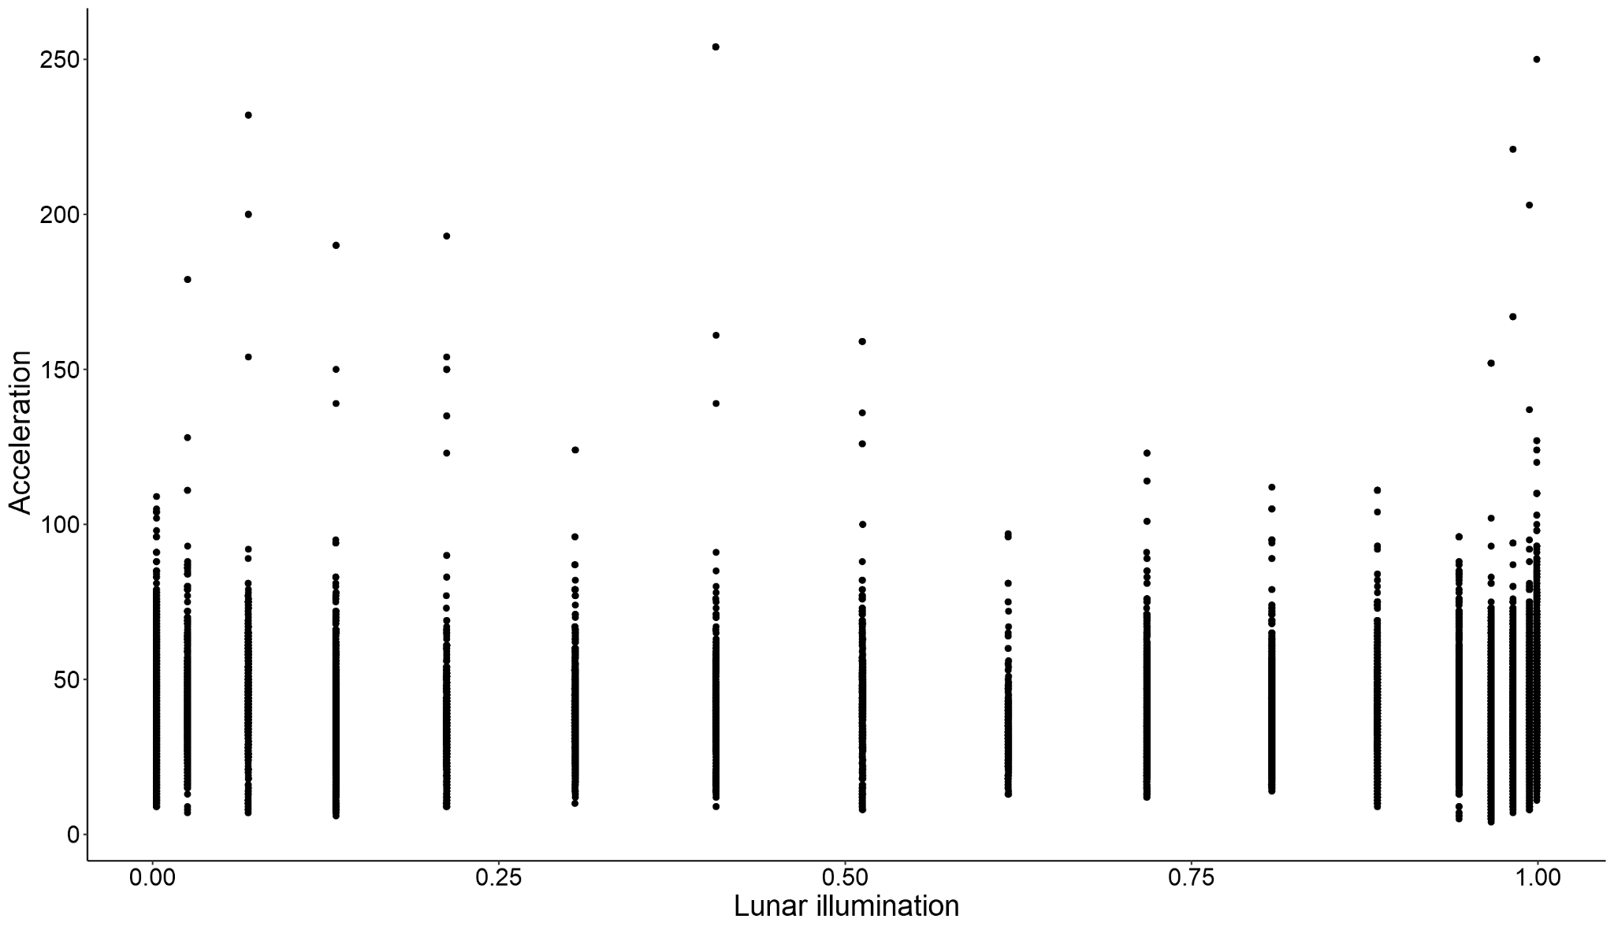
Is activity affected by lunar illumination?

Slide 27
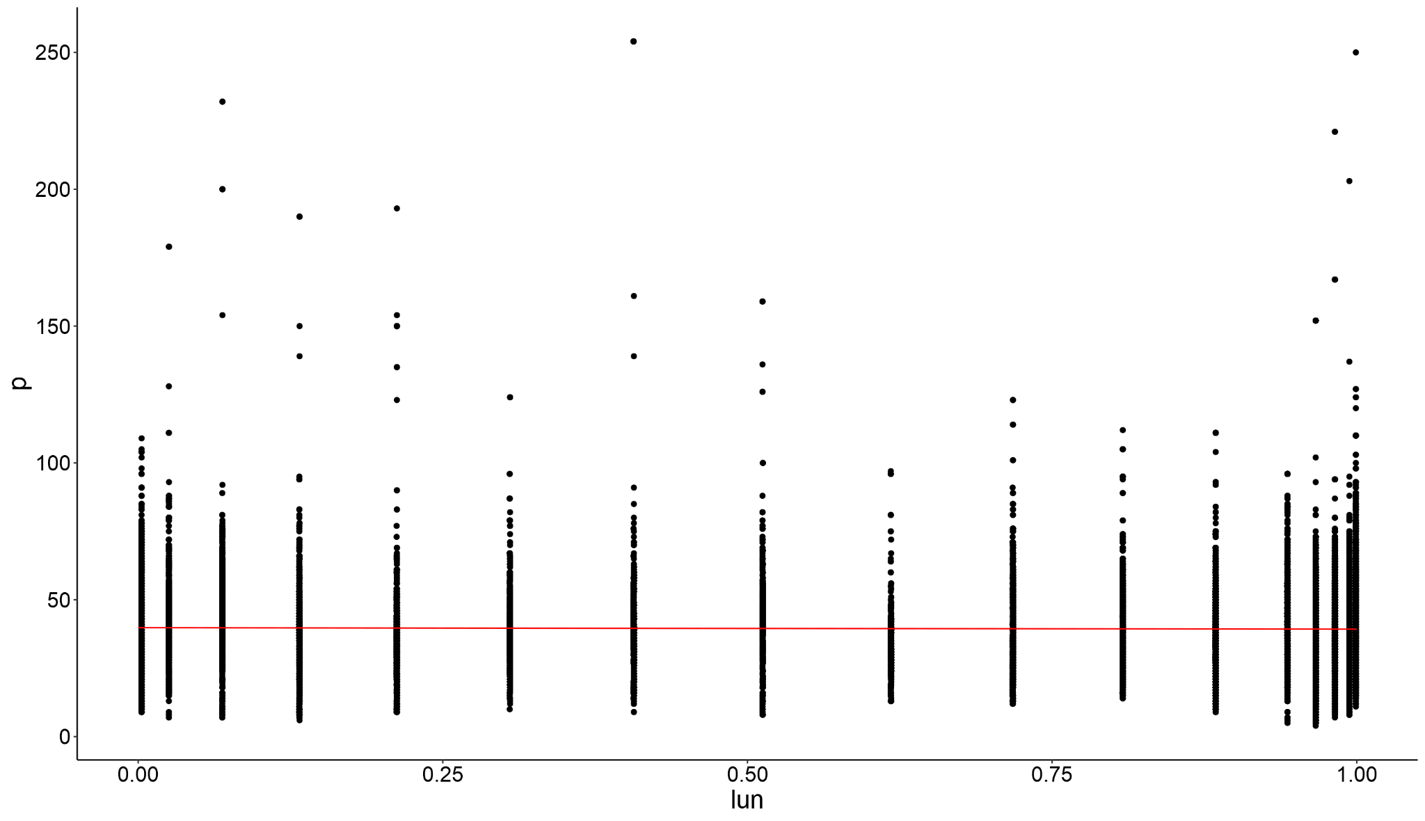
Linear regression acceleration ~ moonlight

Slide 28
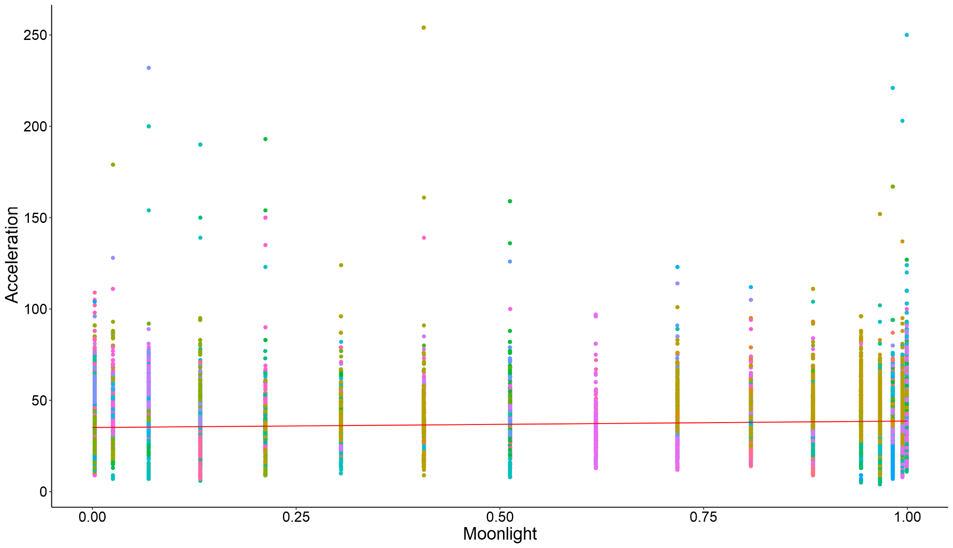
Linear mixed regression acceleration ~ moonlight + (1|ID)

Slide 29

Additive mixed regression moonlight ~ s(moonlight) + (1|ID)

Slide 30
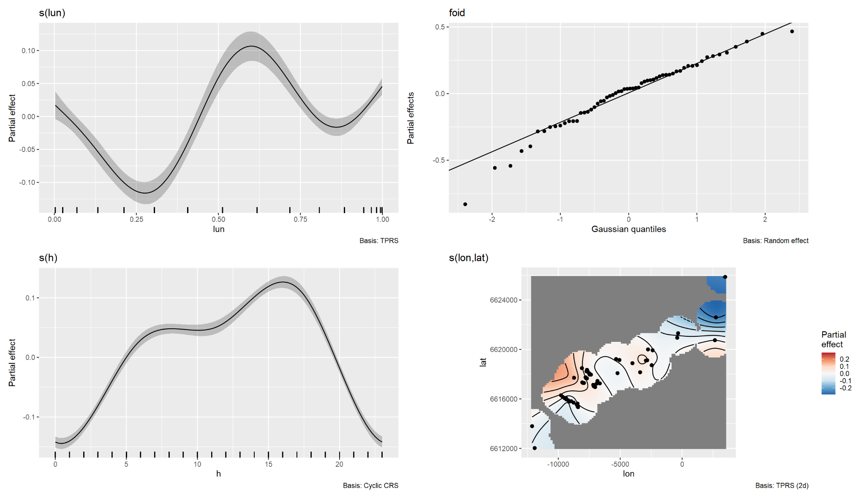
Full model

Slide 31
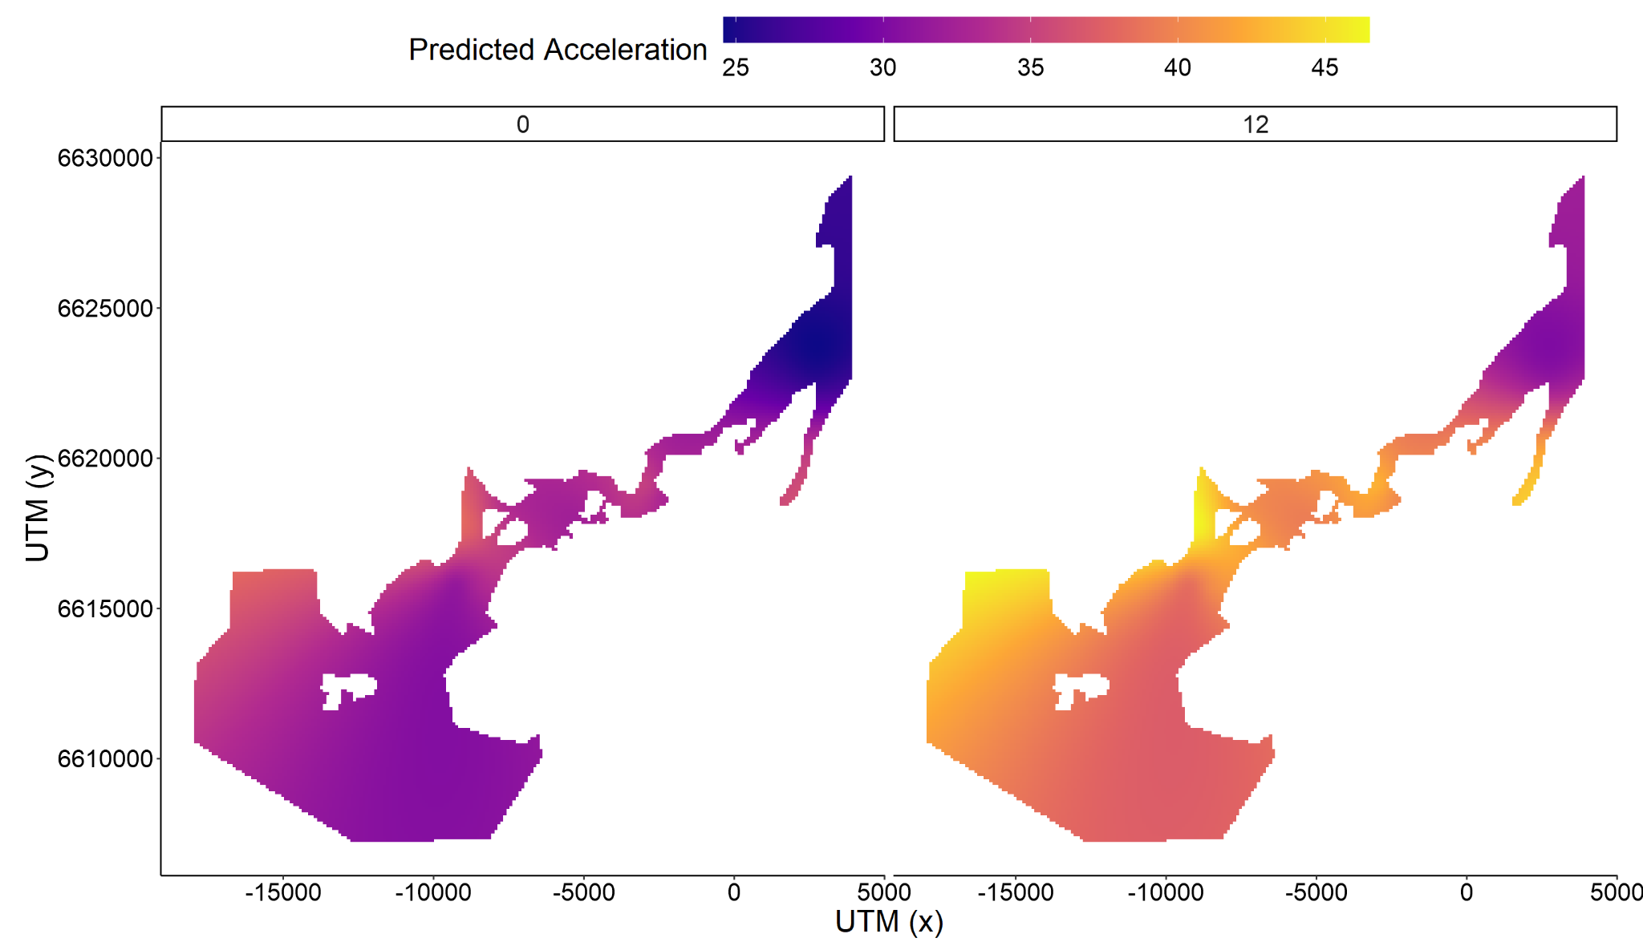
Complex spatiotemporal model

Slide 32
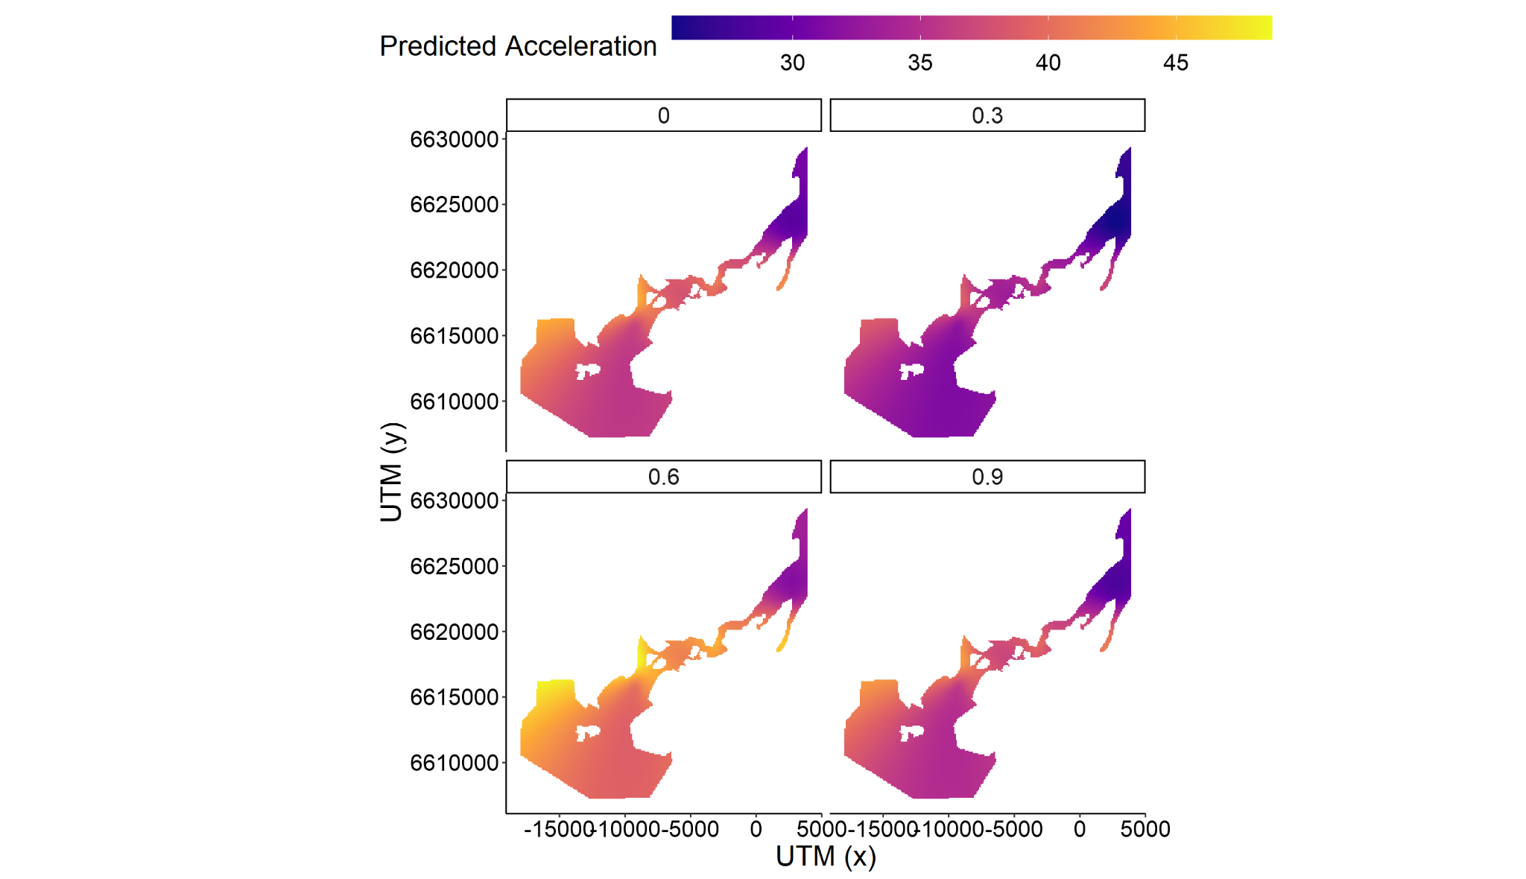
Lunar effects across space

Slide 33
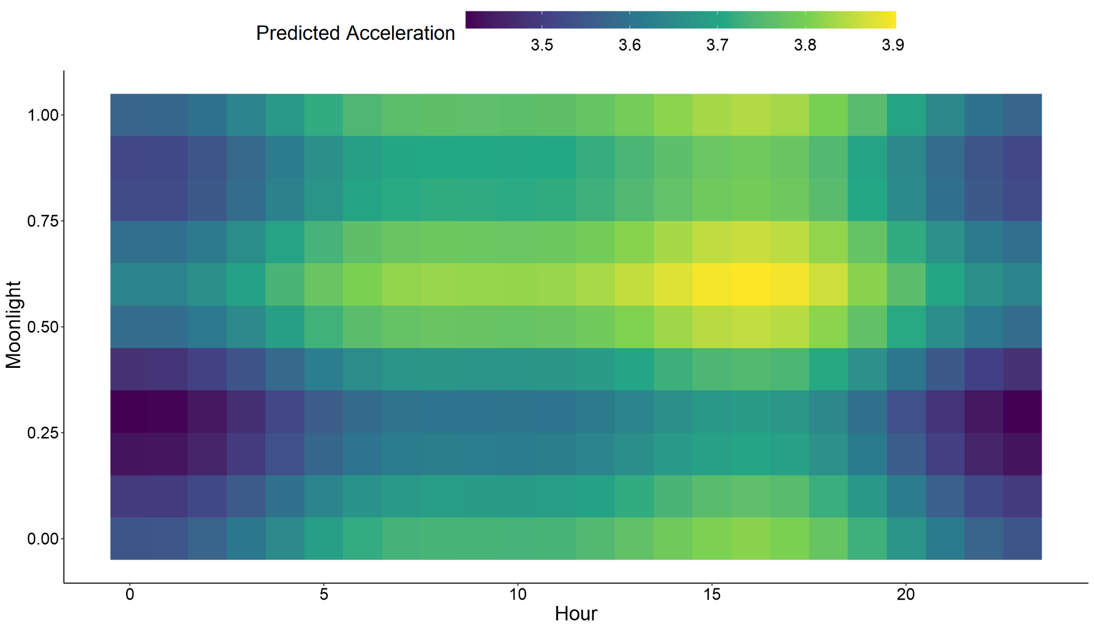
Lunar effects within a day

Slide 34
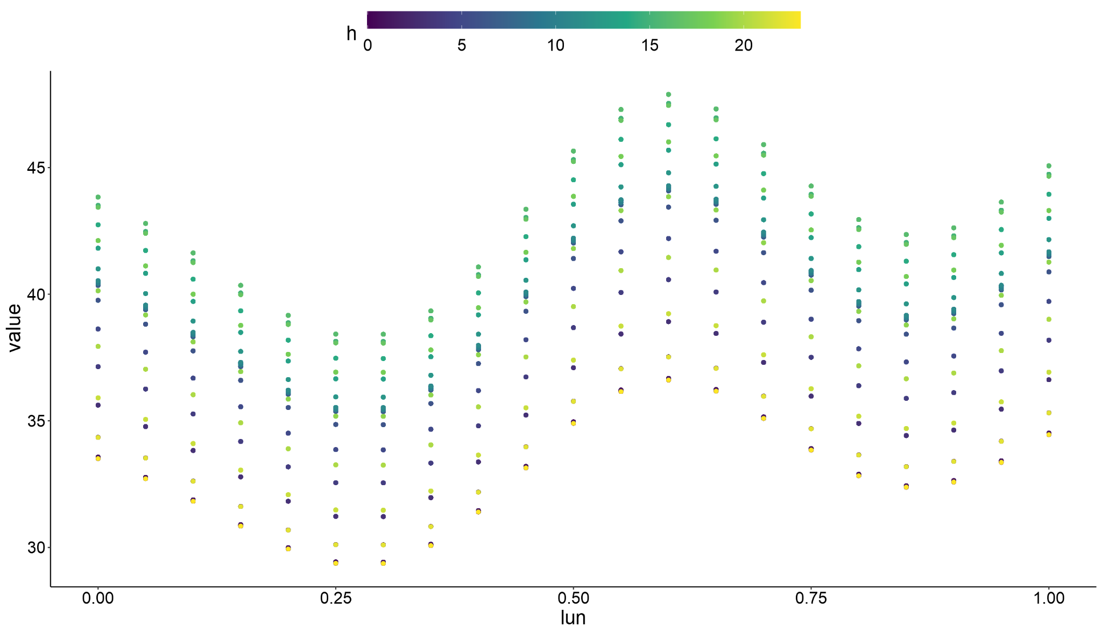

Slide 35
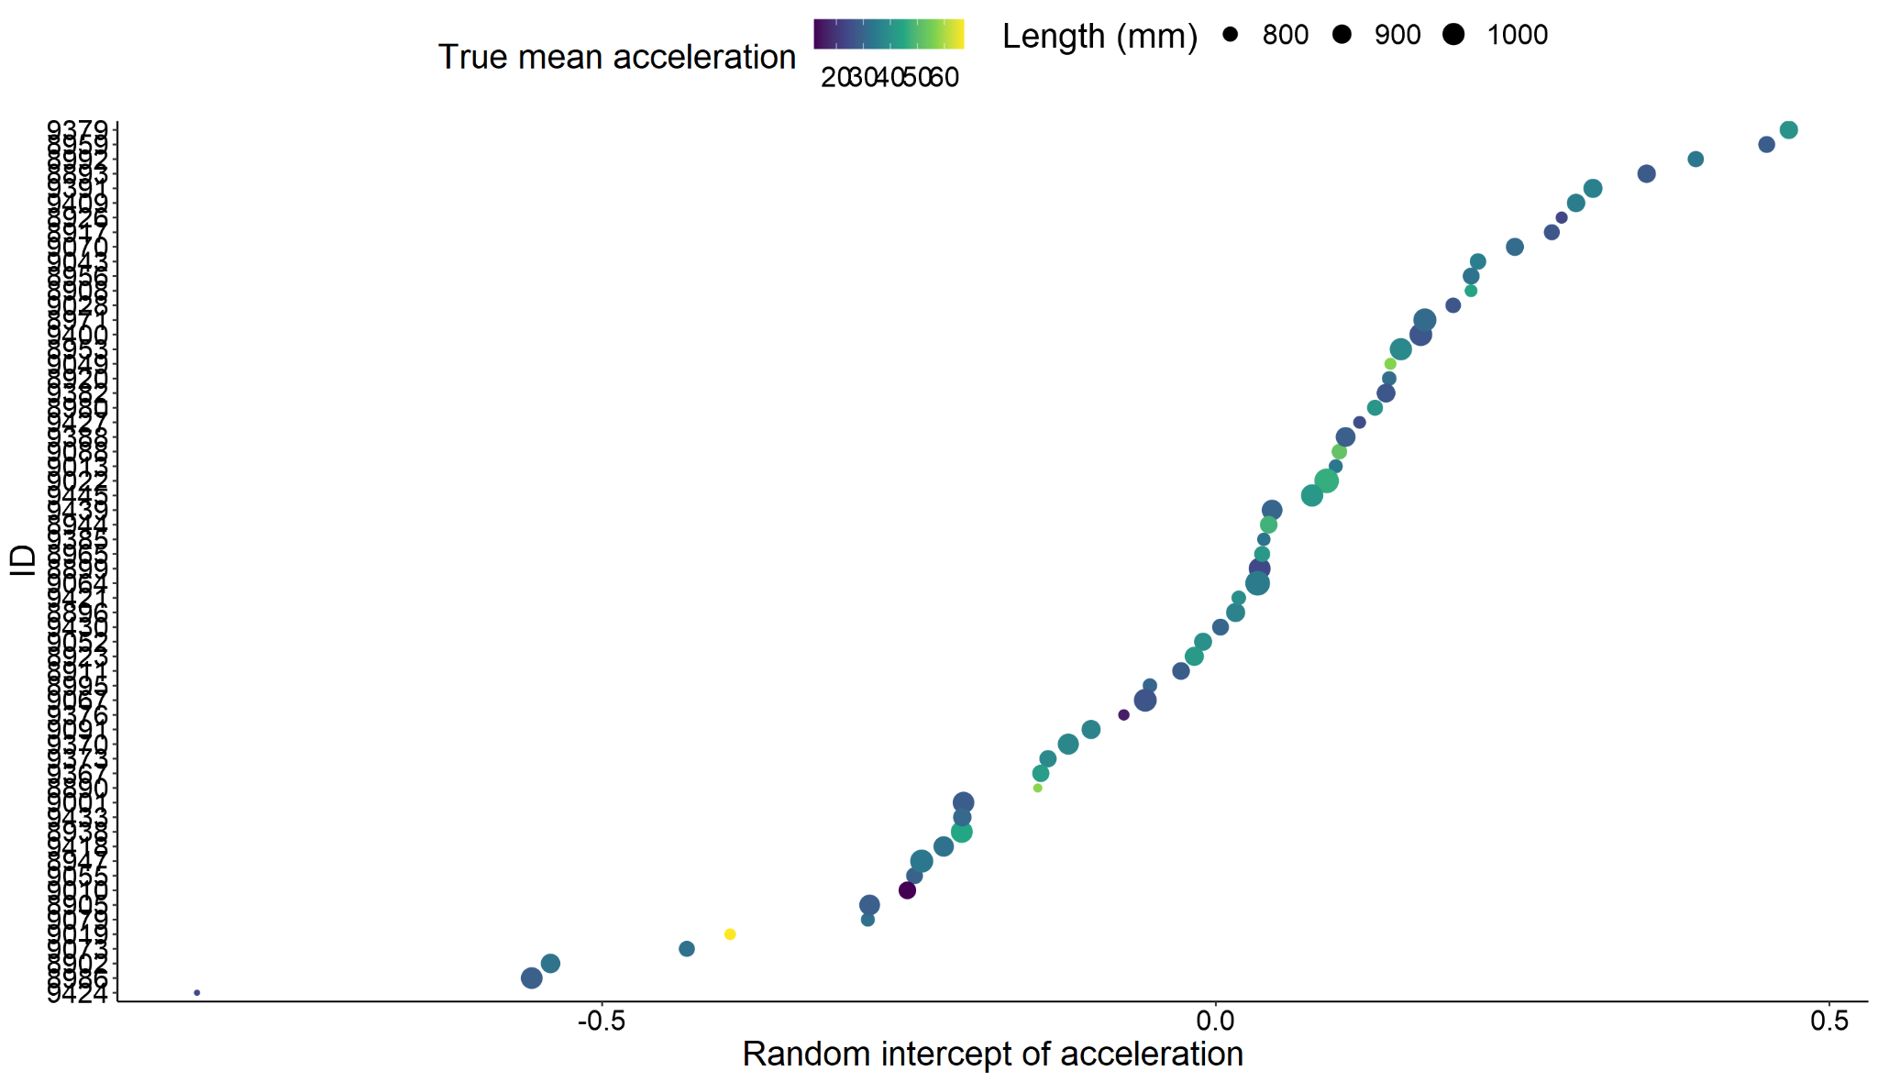
Random intercepts of model

Slide 36
Model summary
All smooths significant
No parametric terms
Bad experimental design, only one moon cycle
Pseudoreplication?
Activity peaks with lunar illumination spurious?
term edf ref.df statistic p.value
<chr> <dbl> <dbl> <dbl> <dbl>
1 s(lun) 5.84 5.99 46.7 0
2 s(foid) 54.8 59 147. 0
3 s(h) 2.99 3 10620. 0
4 s(lon,lat) 20.6 23.0 39.4 0

